Slide 1
Lecture 3 - Norms, Matrix and Vector Calculus Part 1
DS 4400: Machine Learning and Data Mining 1

Slide 2
Today
Norms
Norms in Python
Loading Data into Python using NumPy
Matrix and Vector Calculus
Utility of Matrix and Vector Operations Derivatives with Matrices
Practice Problems

Slide 3
What are norms
norms are mathematical tools used to measure the "size," "length," or "magnitude" of vectors, matrices, or functions.
In the context of ML, norms are used in regularization of models
What’s regularization in layman terms, and why is it important?

Slide 4
Regularization (in layman terms)
The term regularization comes from the idea of making something "regular" or well-behaved.
In the context of ML, regularization is a technique to encourage models (e.g. neural networks) to behave in a more predictable, generalizable, and simpler way.
Norms introduce a penalty term in the model to strike a balance between complexity and simplicity.
This leads to models that perform well on real-world data.
Different norms introduce different types of penalties.

Slide 5
L1, L2 and L-infinity norms
There are many types of norms used by data scientists. The most common ones are Lp norms, denoted as ||x||_{p}:
L1 norm, ||x||₁
aka Manhattan norm
L2 norm, ||x||₂
aka Euclidean norm
L-infinity norm, ||x||∞
aka uniform norm, maximum norm, or supremum norm

Slide 6




The "L1 norm" calculates the "length" of a vector by summing the absolute values of all its components.
Also known as:
"Manhattan distance" or "taxicab norm" because it represents the distance traveled in a city grid by only moving along axes.
Applications:
Feature selection in machine learning.

Slide 7



The "L2 norm" calculates the "length" of a vector by taking the square root of the sum of the squares of all its components.
Also known as:
Euclidean norm because it represents the straight-line (Euclidean) distance between two points in space.
Applications:
Common in machine learning for regularization (e.g., Ridge regression) because it penalizes large weights smoothly, leading to models that generalize better by discouraging extreme values while retaining all features.

Slide 8





The "L∞ norm" calculates the "length" of a vector by taking the maximum absolute value of its components.
Also known as:
Maximum norm or Chebyshev distance because it represents the greatest absolute distance in any single dimension.
Applications:
Used in optimization problems to bound the largest error or ensure robustness by controlling the maximum deviation in solutions. It is particularly useful in settings where outliers or extreme values are critical.

Slide 9
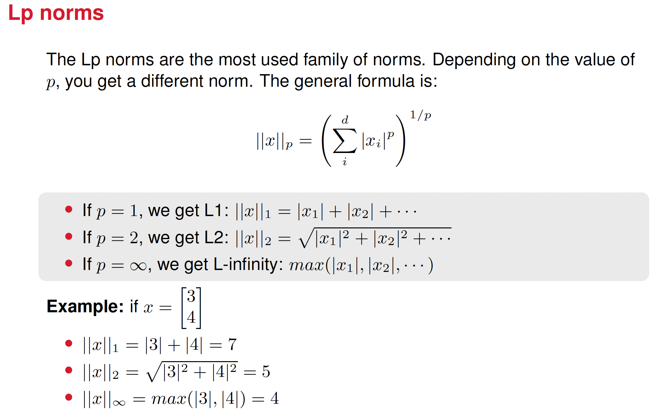

Slide 10
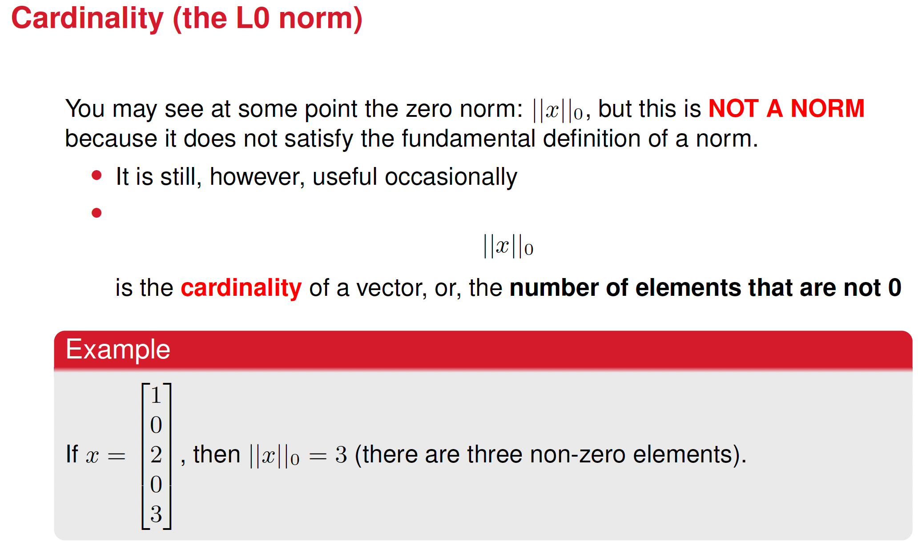

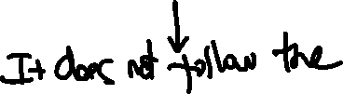



Slide 11

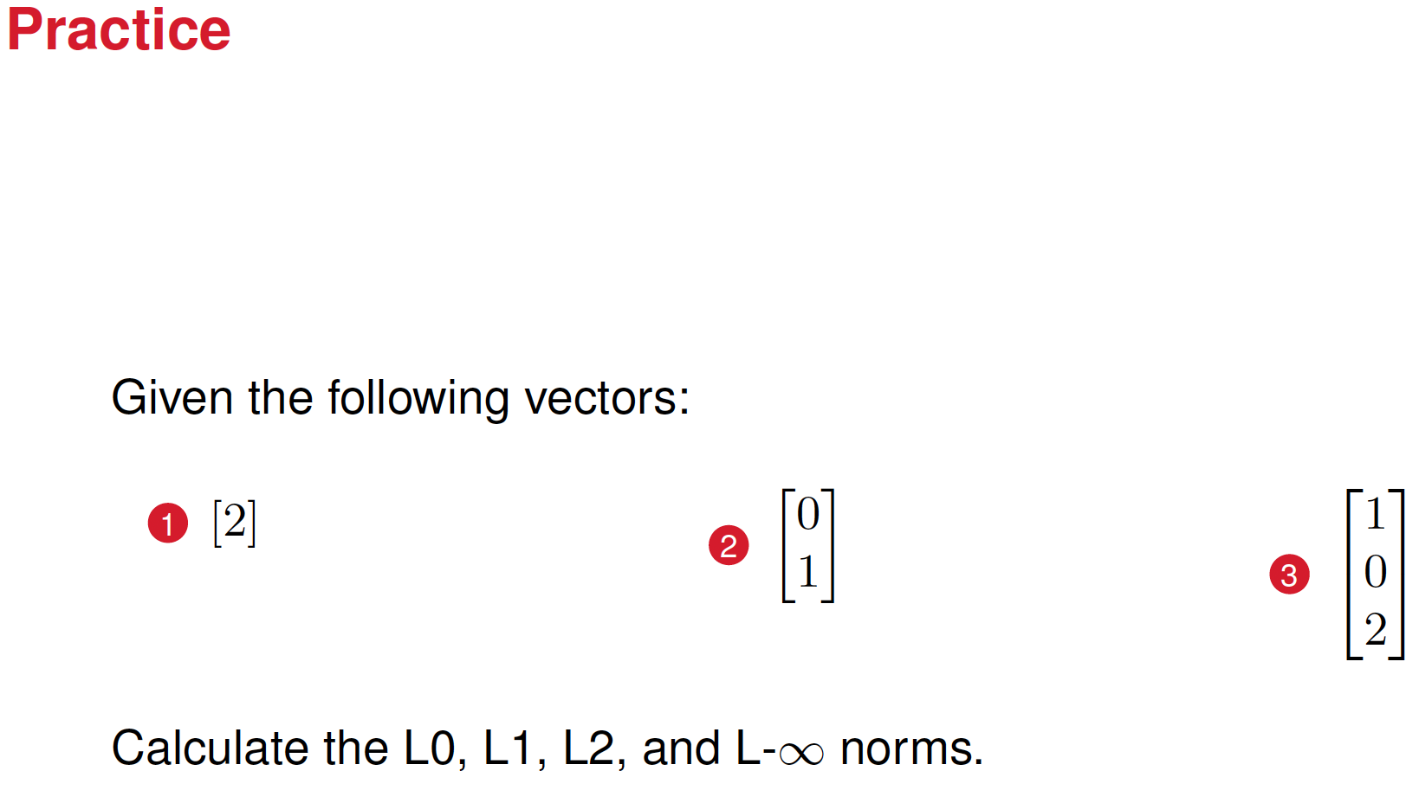
https://create.kahoot.it/share/ds-4400/b4792ef6-7afd-401f-90d2-544b877a5ba7

Slide 12
























Solutions

Slide 13
Norms in Python
The NumPy package has a very convenient function for finding the Lp norm of any vector. Check out its usage in the norms matcalc.ipynb file on Canvas. Note: you need a different function for the L0 norm.

Slide 14
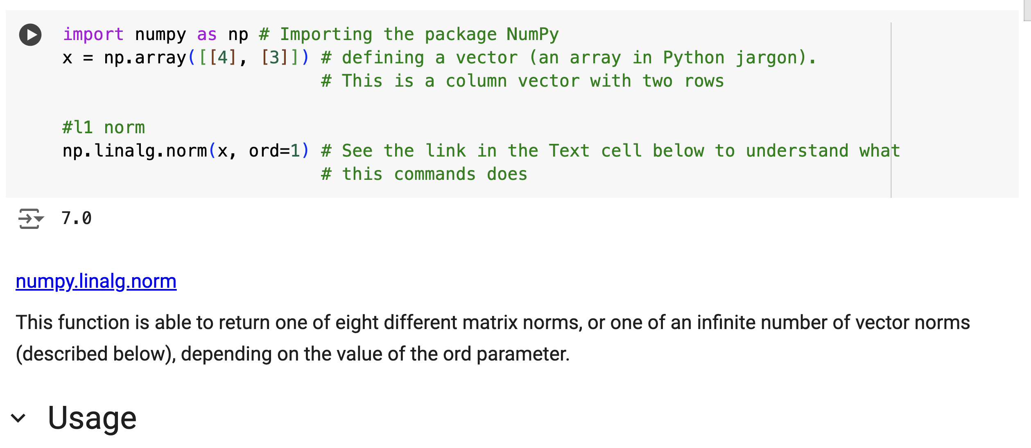





See the code norm_matcalc.ipynb in CANVAS

Slide 15









Matrices, vector operations and linear models
A linear model: a mathematical function that maps a set of input (features) to an output using a linear combination of the features.
Where:
x=[x₁,x₂,…,x_{n}] is the vector of input, the features.
w=[w₁,w₂,…,w_{n}] is the vector of weights (coefficients) that determine the importance of each feature
w^{T}x is the dot product of w^{T} and x

Slide 16
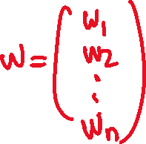
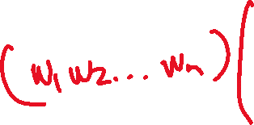












Slide 17
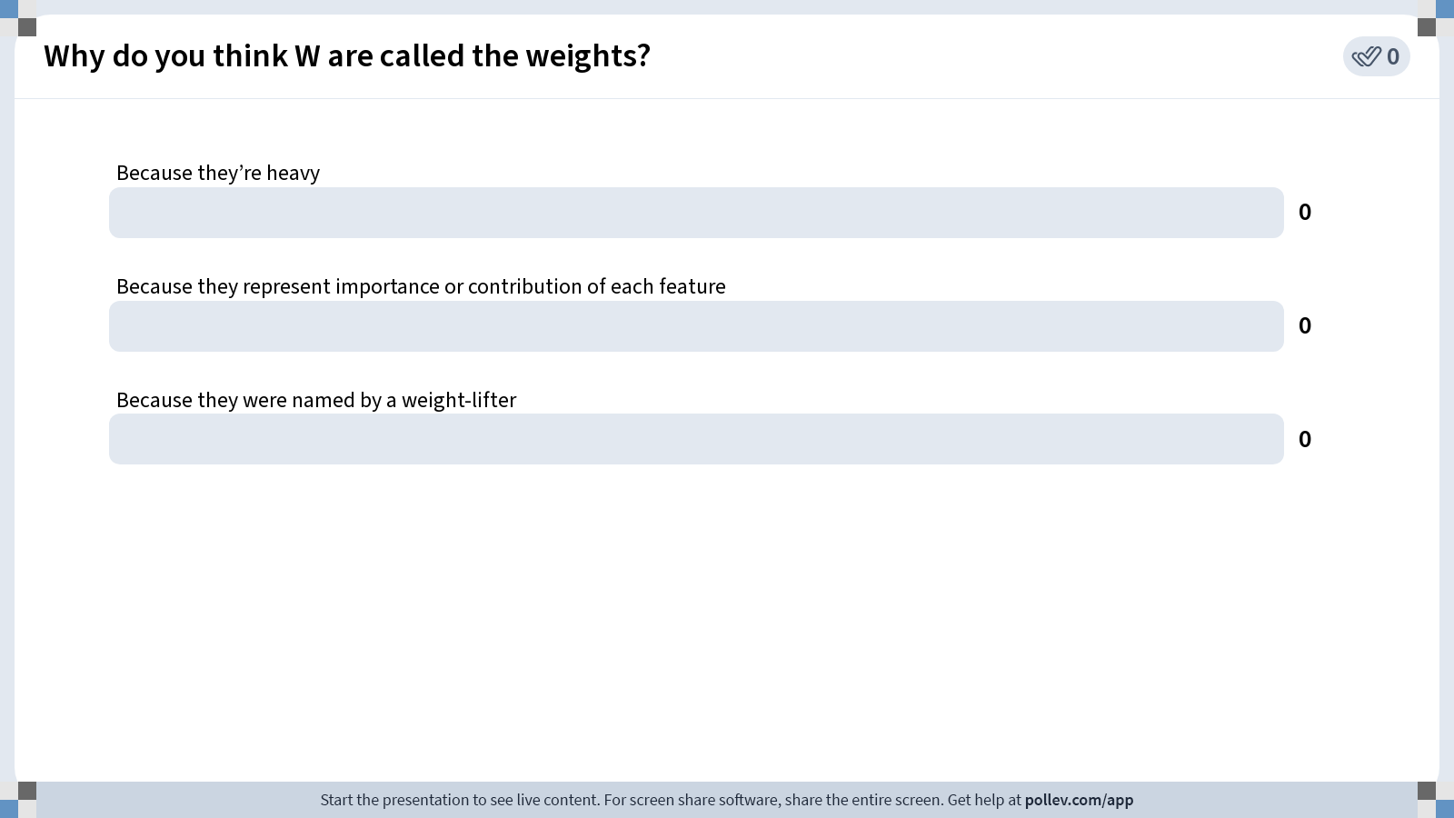
Notes:
Do not modify the notes in this section to avoid tampering with the Poll Everywhere activity. More info at polleverywhere.com/support Why do you think W are called the weights?
https://www.polleverywhere.com/multiple_choice_polls/WJcjocSY8dkhYXlrLxOeF?state=opened&flow=Default&onscreen=persist

Slide 18
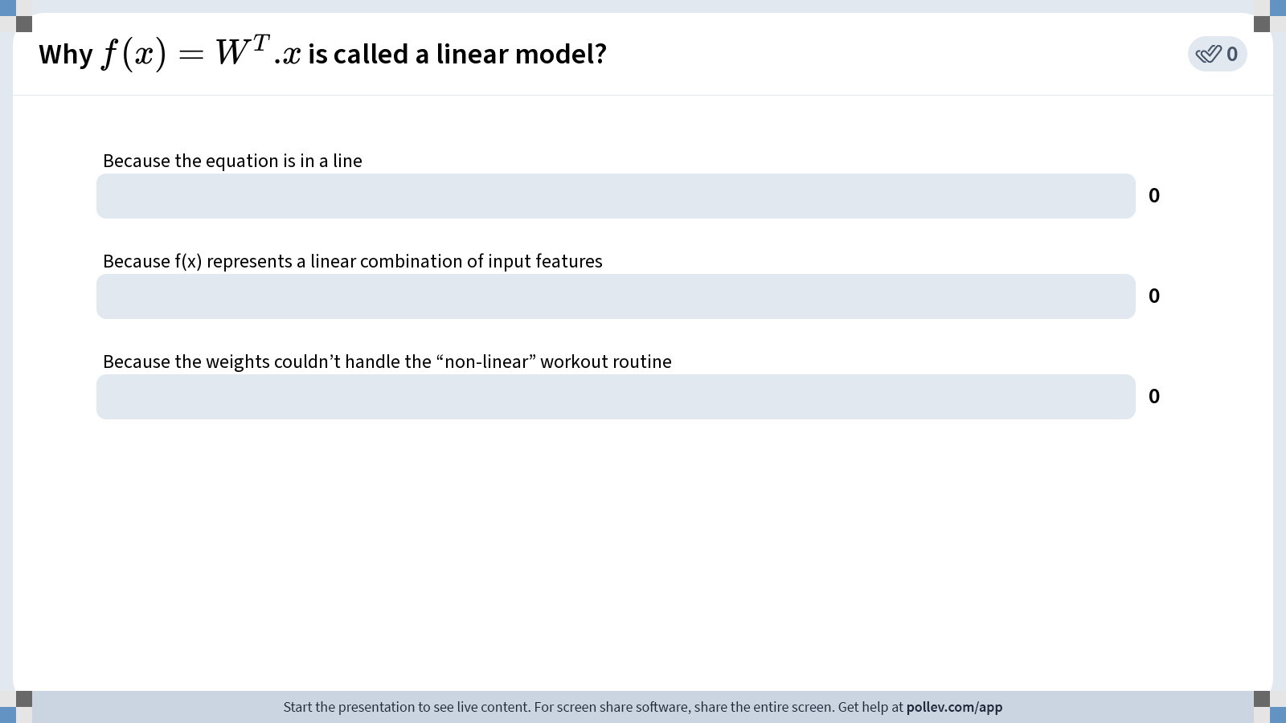
Notes:
Do not modify the notes in this section to avoid tampering with the Poll Everywhere activity. More info at polleverywhere.com/support Why $$f(x) = W^T.x$$ is called a linear model?
https://www.polleverywhere.com/multiple_choice_polls/HvIkG0gdPBGg2CPaIYWxD?state=opened&flow=Default&onscreen=persist

Slide 19
Examples of linear models
Linear regression
Logistic Regression
Both fall within the category of Supervised Learning.

Slide 20
What’s supervised learning?
A type of machine learning technique where we teach a computer to make predictions based on labeled examples we provide.
How it works:
Give the computers labeled examples: data (input) along with the correct answers (output). For example, if we want it to recognize cats, we give it pictures of animals and label each one as "cat" or "not cat.”
Let the computer learn patterns: The computer looks for patterns in the data to figure out how the input is connected to the output
Test the computer’s knowledge: Once trained, we give it new data without the answers (labels) and see if it can predict the correct output.

Slide 21

https://www.youtube.com/watch?v=g9oESGzcA84
Notes:
Use this slide to explain a bit better what supervised learning is

Slide 22
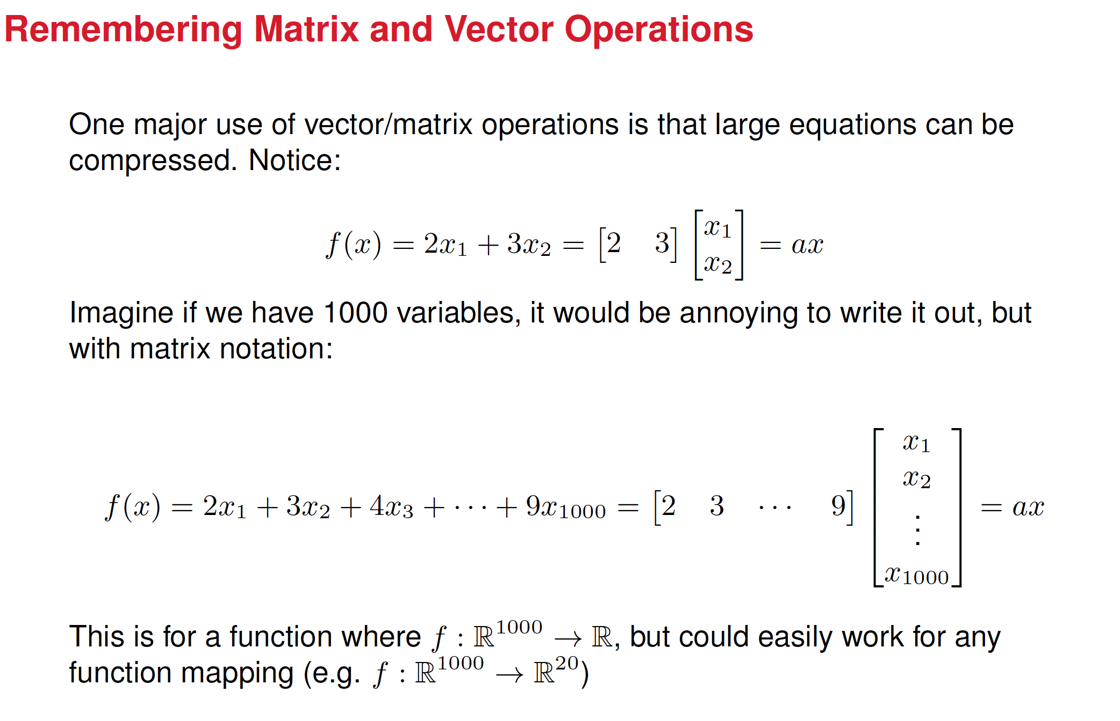

Slide 23
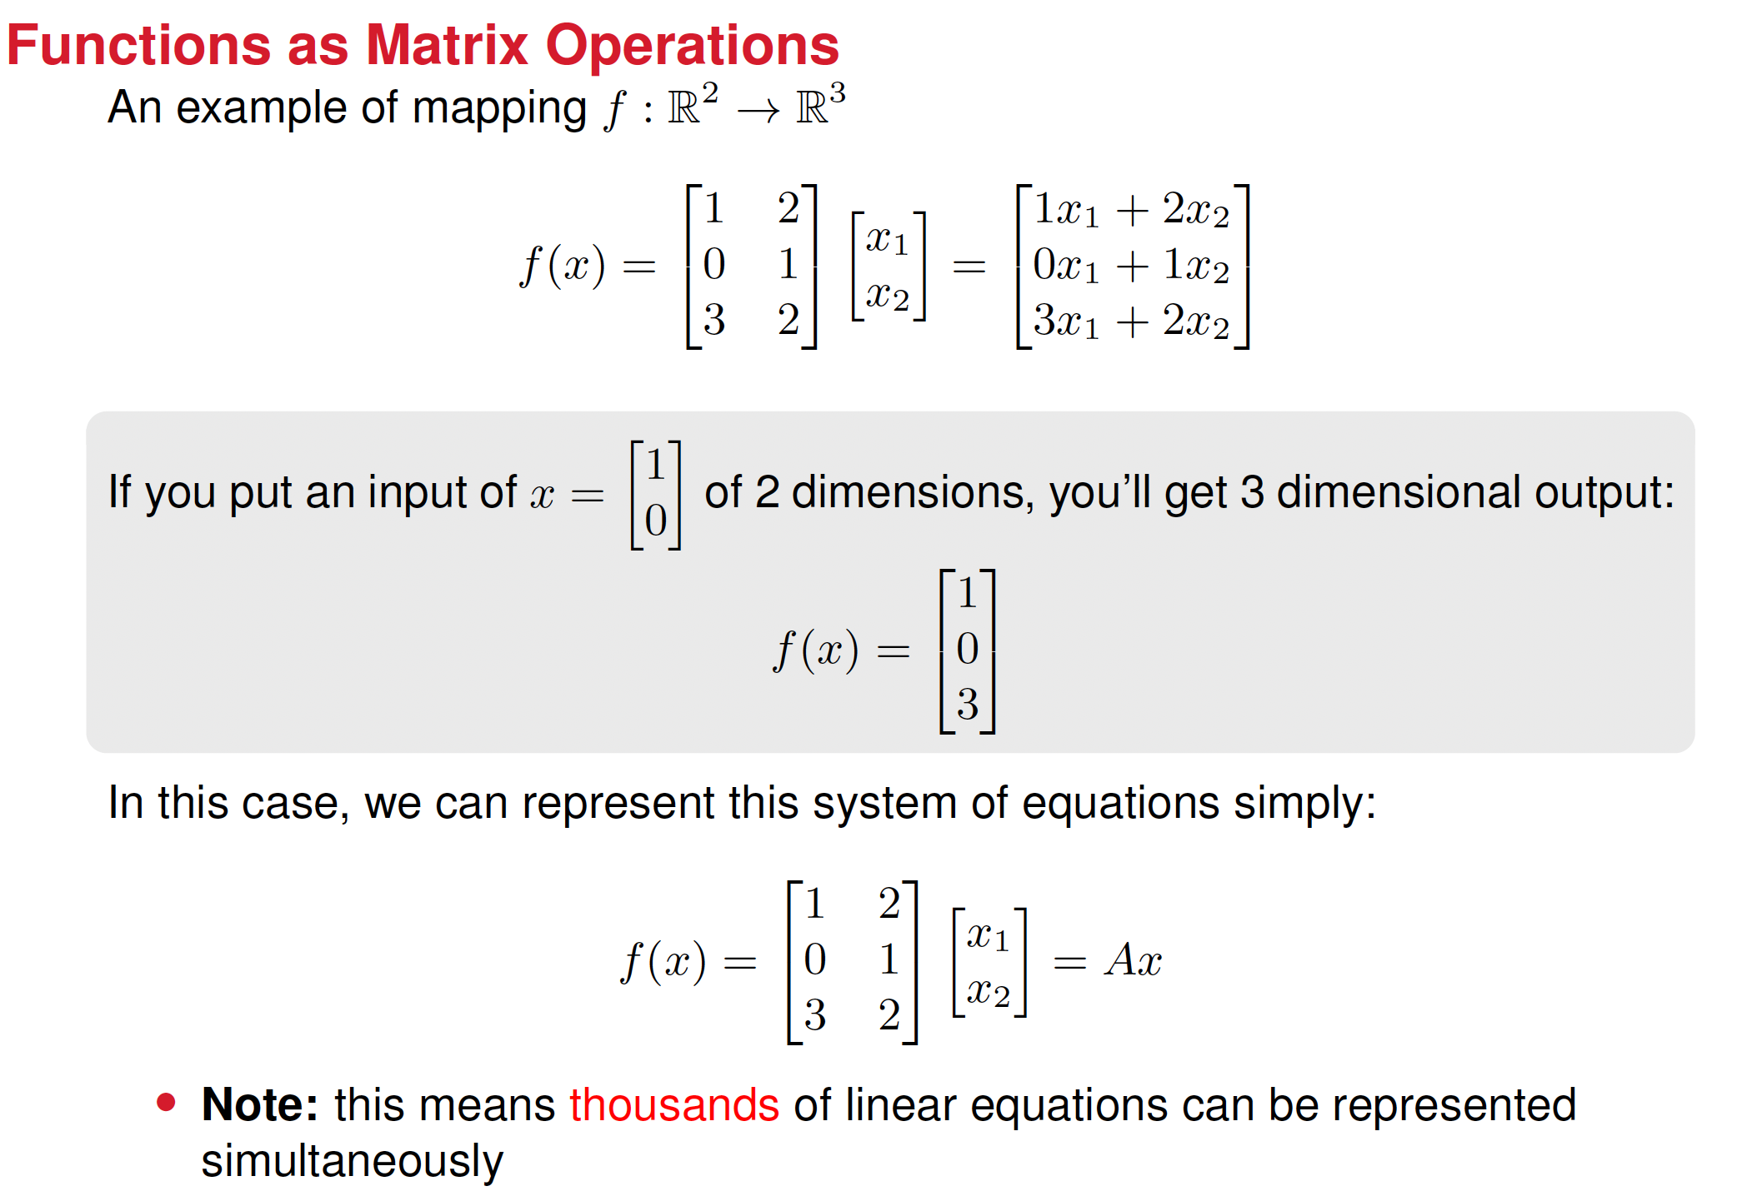

Slide 24
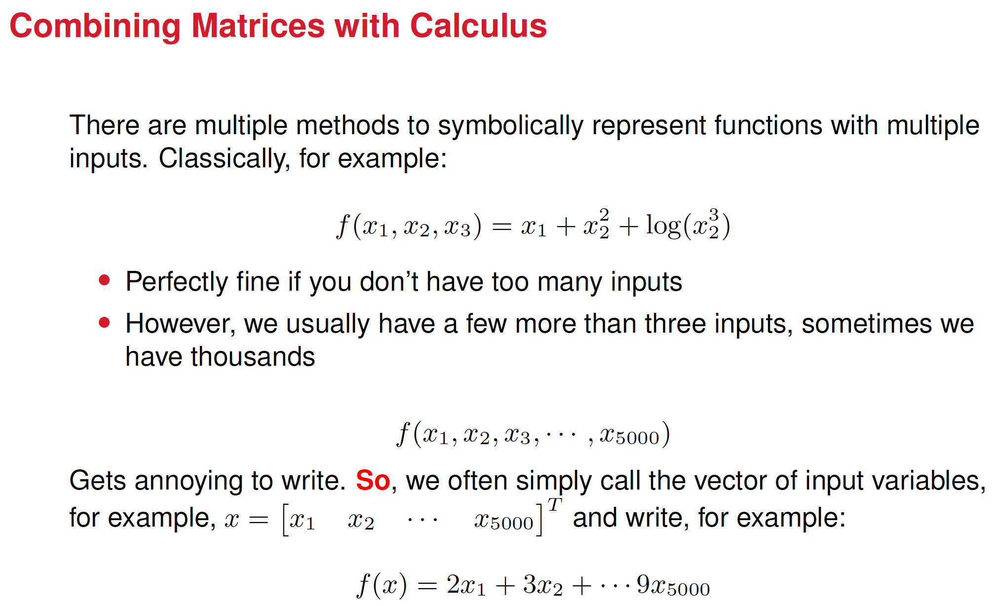

Slide 25
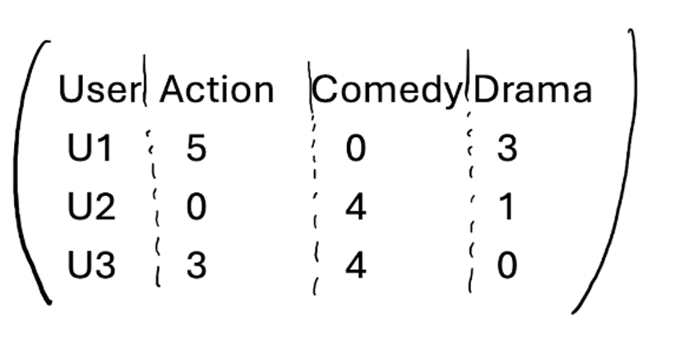
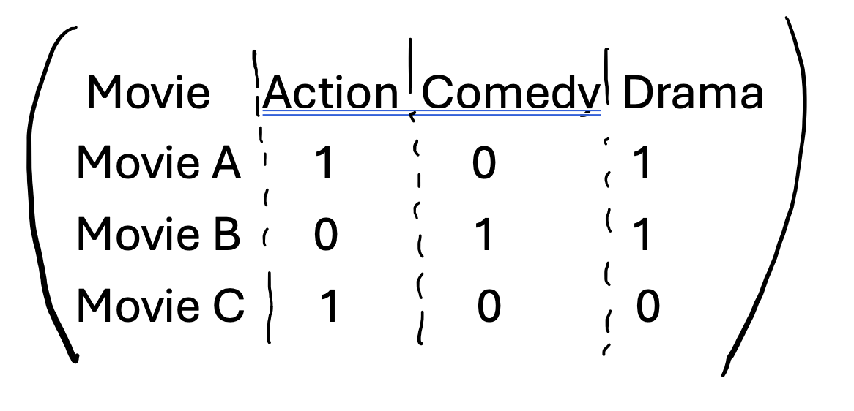
Revisiting the movie recommendation system

Slide 26
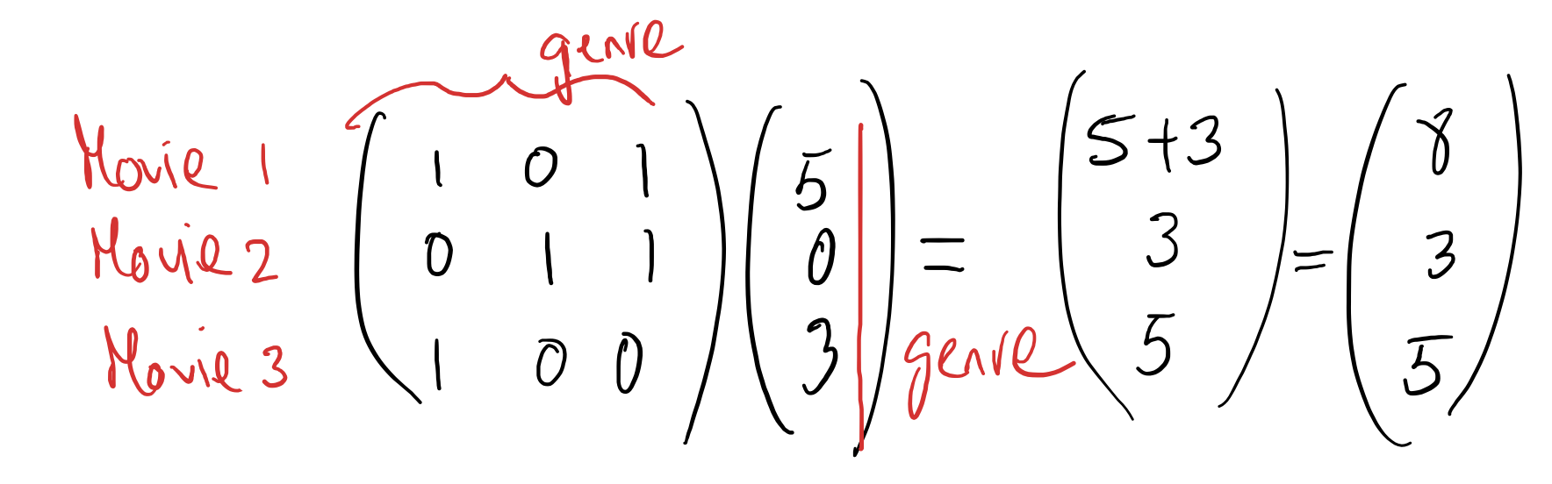

How user U1 ranks each movie
Can you write the expression above in a simplified form?

Slide 27




How user U2 ranks each movie
Can you write the expression above in a simplified form?

Slide 28

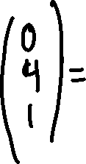


How user U3 ranks each movie
Can you write the expression above in a simplified form?

Slide 29












Notice that for each user, a movie’s score is a linear combination of genres where coefficients in the linear combination are the user's preferences for those genres.

Slide 30
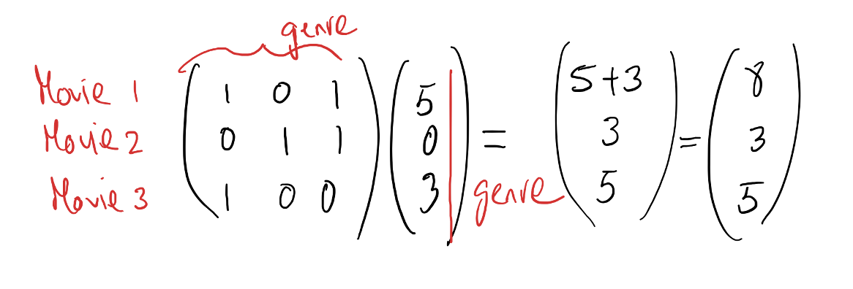
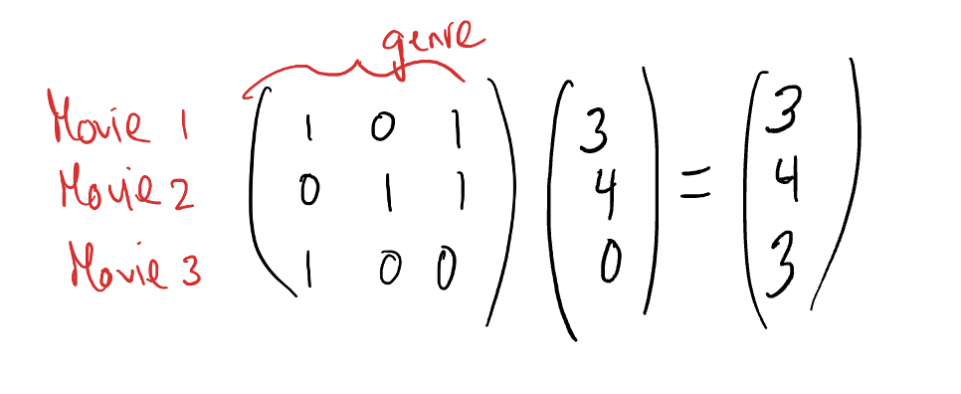
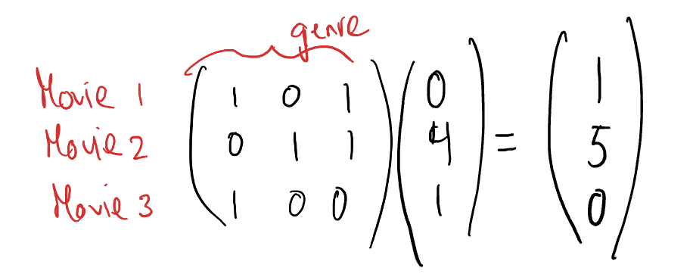



Summarizing

Slide 31






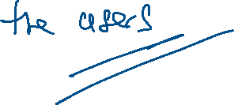



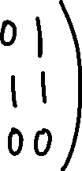

Summarizing even further

Slide 32





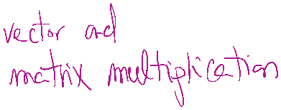
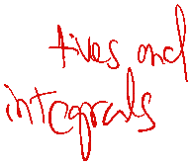

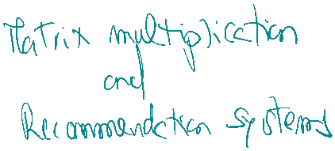



Roadmap to ML so far

Slide 33
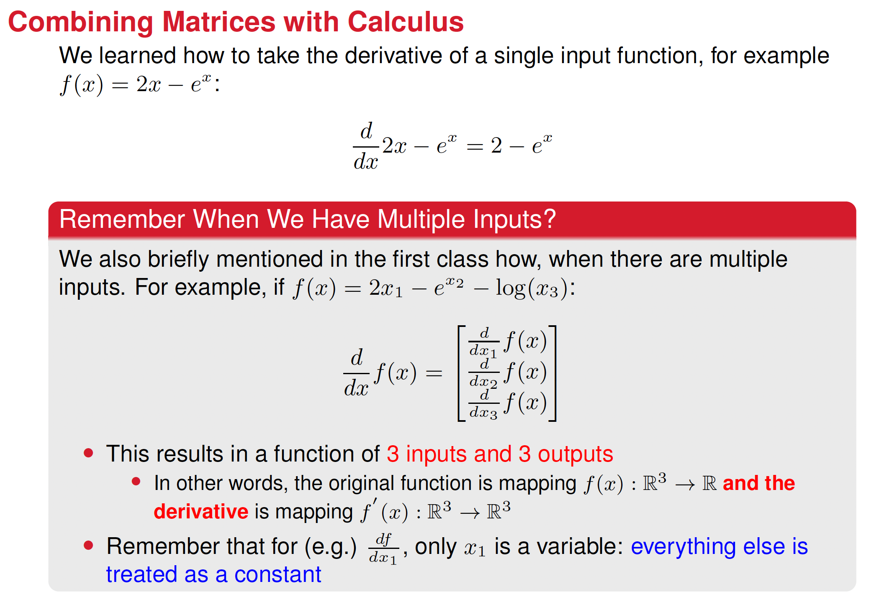

Slide 34
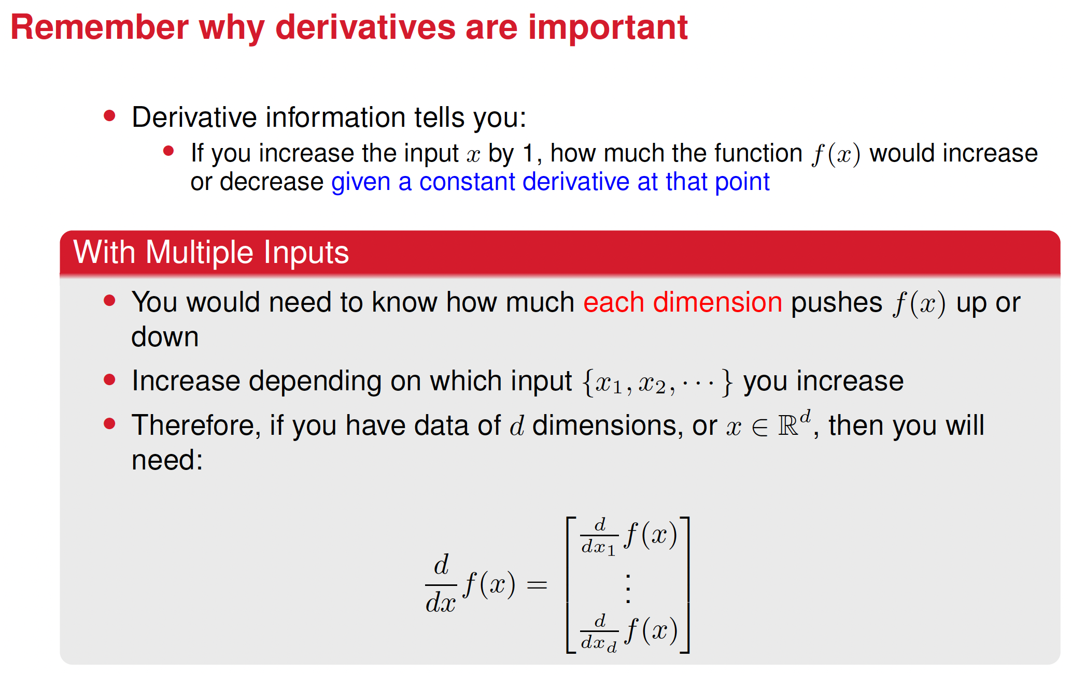

Slide 35
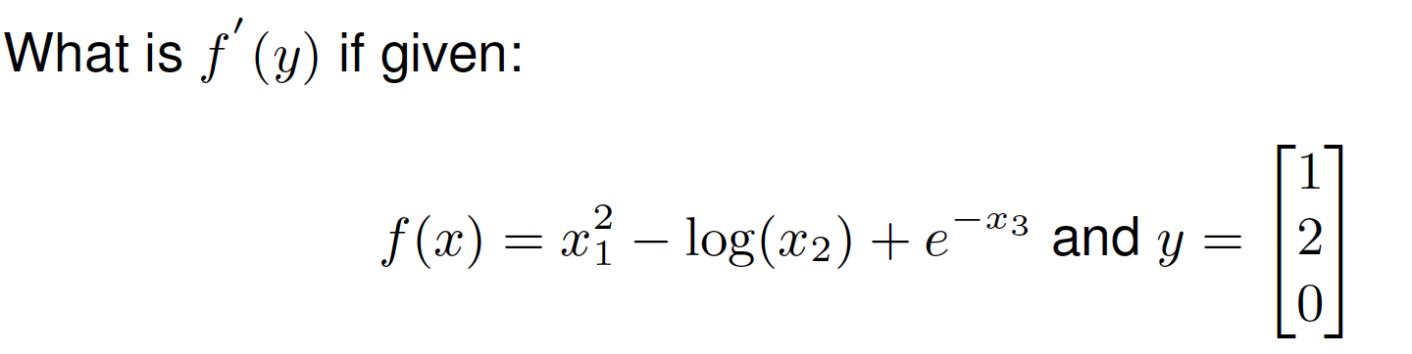
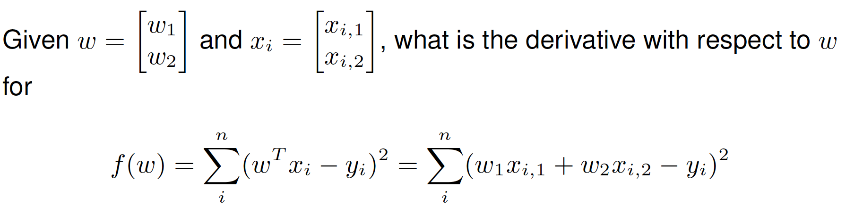
Practice exercises

Slide 36












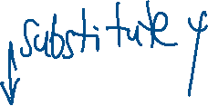




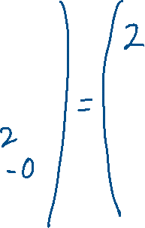
















Solutions

Slide 37











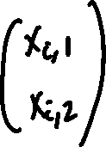



















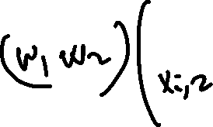






Slide 38

























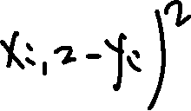








Slide 39


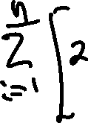
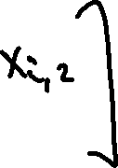















Slide 40
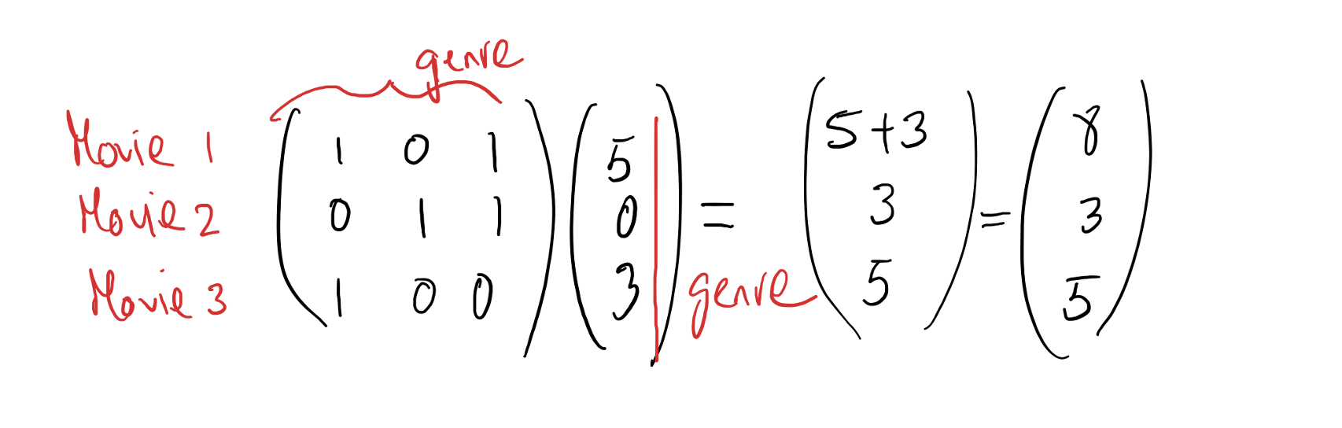













Revisiting the movie recommendation example

Slide 41











Rewriting it some more

Slide 42
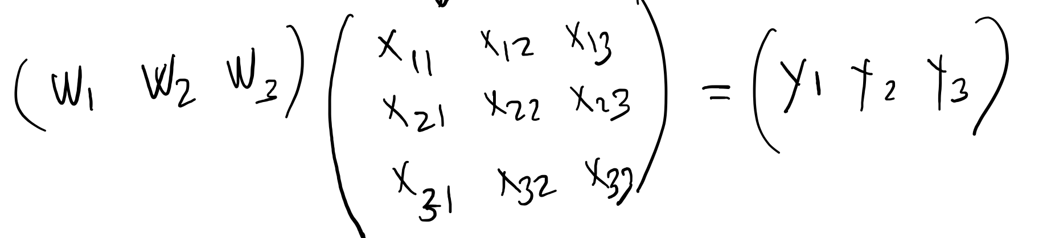























Slide 43
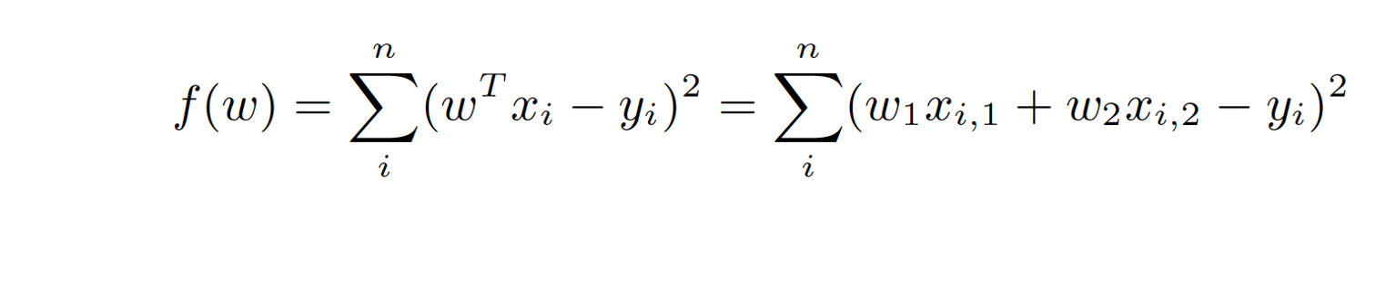
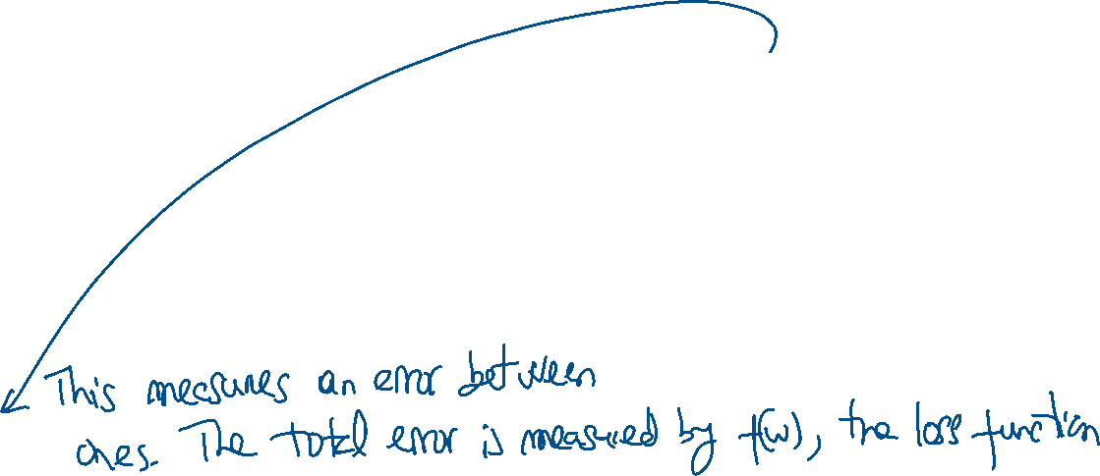
























Slide 44


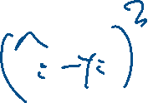










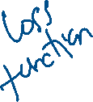


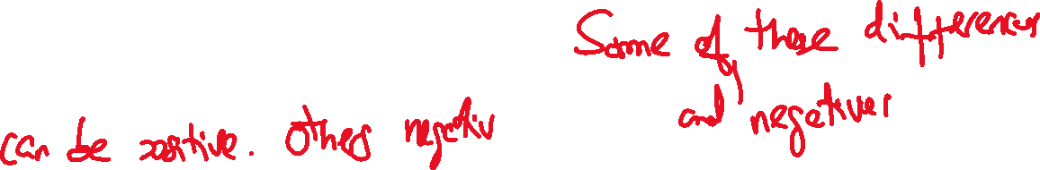






Slide 45
By squaring, we measure errors in predictions.
If we don’t square, the errors can be positive and negative, and this can result, by cancellation, in a loss function equal to 0.
When we square it, cancellation does not happen.
By computing the derivative, we tuned the weights to reduce the error.
Derivatives allow us to find the weights that make the errors smaller. And the finding is clever, not random.

Slide 46
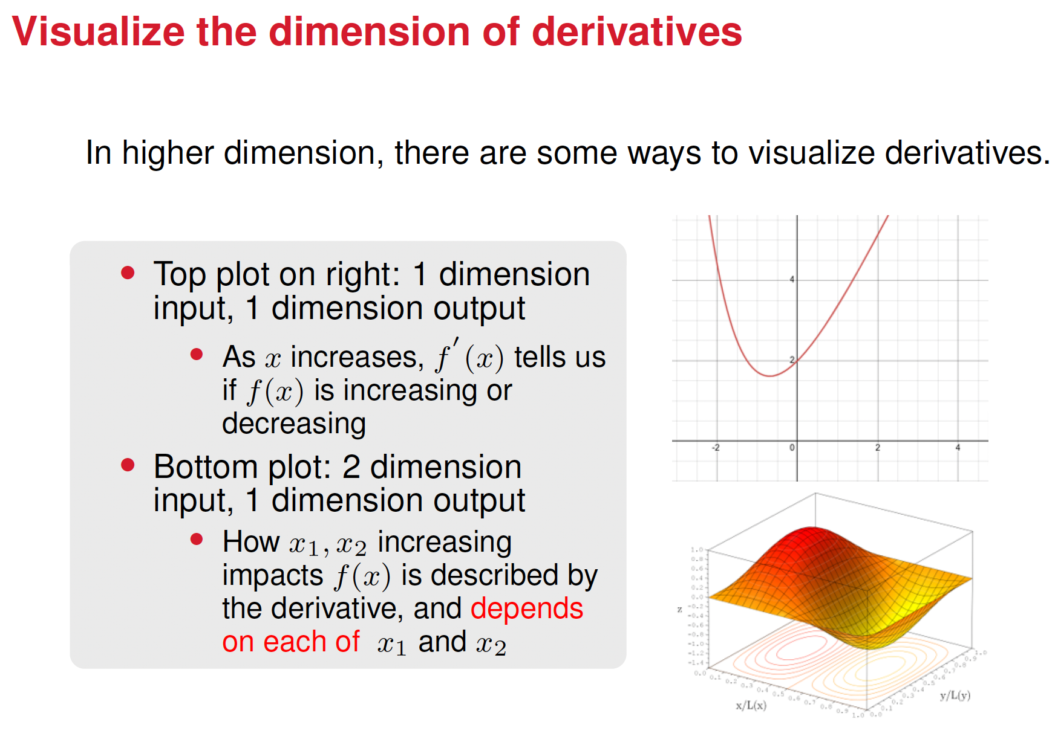






Slide 47
Why Derivatives Are Important in Machine Learning
Derivatives guide models on how to adjust parameters to make better predictions by minimizing errors.
Why they matter:
Direction: Indicate whether to increase or decrease weights to reduce errors.
Step Size: Show how much to adjust weights for efficient learning.
Systematic Learning: Ensure the model learns quickly and effectively, avoiding random guessing.
Analogy:
Like a GPS for finding the lowest point in a valley:
Without derivatives: Random stumbling.
With derivatives: Follow the slope downhill systematically.
Derivatives are essential for training models efficiently and accurately by helping them improve step by step.

Slide 48
Loading .csv using NumPy
You may have used Pandas before to read .csv files into Python, but did you know NumPy can do it to?
Check out the next few cells of norms matcalc.ipynb on Canvas. You’ll need the numonly gtky.csv file that is also on Canvas (it contains only the numeric features from the survey, the credit hours and work hours).

